Slide 1




CREDIT RISK
PREDICTION
By : Algi Atian Akhyarter.

Slide 2
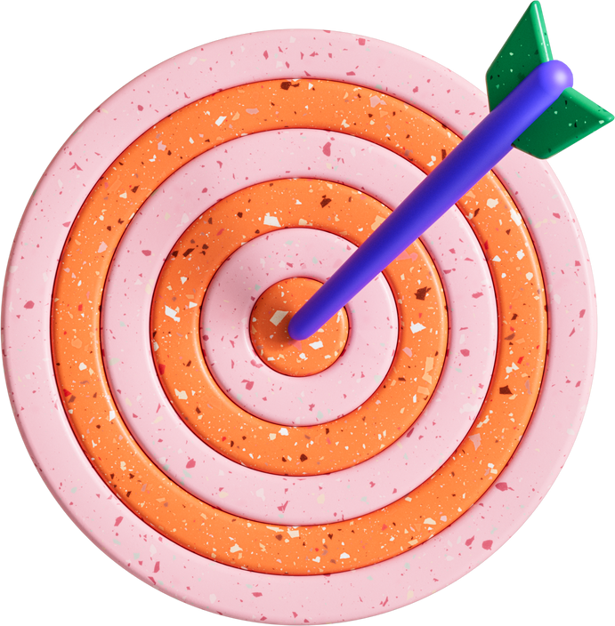


Introduction
"Credit Risk is a model used to predict
which loans are likely to default."

Slide 3


Table of Content
Exploring Data
LabelingData
Data Splitting
Feature Enginering
Modeling

Slide 4

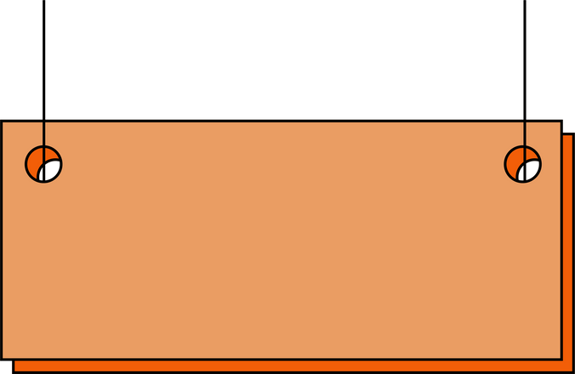
Customer Clasifikasi Status
Good Borrower
Bad
Borrower
Current
Fully Paid'
In Grace Period'
Charged Off
Default
Late
Does not meet the credit policy

Slide 5
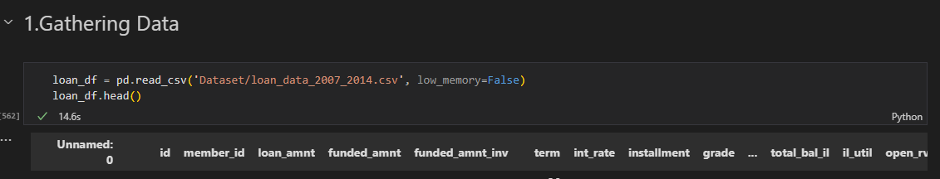

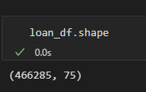
Data Exploring
"Gathering data from the provided
dataset, which contains
466,285 rows and 75 columns."

Slide 6

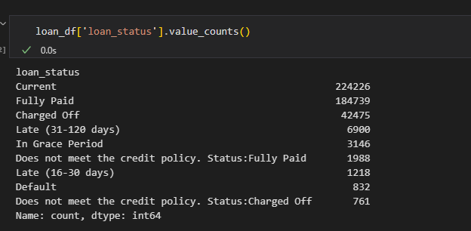
Labeling Data
Labeling loan statuses numerically for differentiation between 'good' (0)
and 'bad' (1) as follows:
- 'Good' (0): ('Current', 'Fully Paid', 'In Grace Period')
- 'Bad' (1): ('Default', 'Late (31-120 days)', 'Late (16-30 days)', 'Does
not meet the credit policy.Status: Fully Paid','Does not meet the
credit policy. Status: Charged Off')"

Slide 7
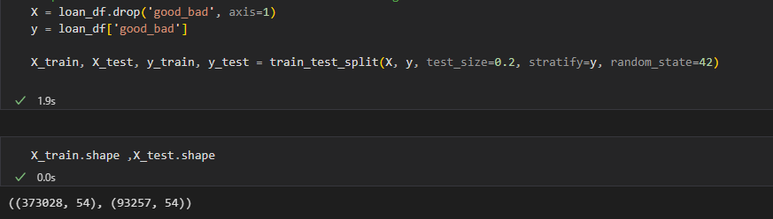
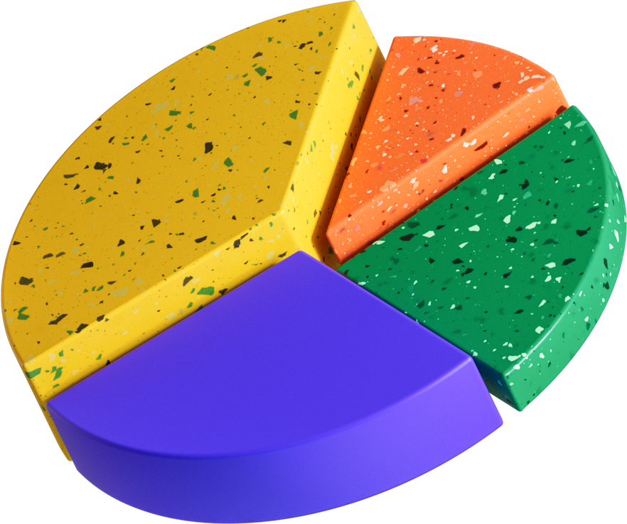

Data Splitting
Split the data into an 80/20 ratio while maintaining the distribution of bad loans in the test set as in the training set.

Slide 8

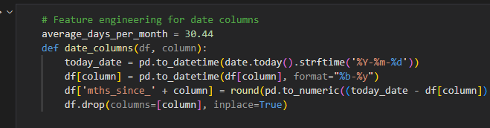

Feature Enginering
Uses a Logistic Regression model to predict credit risk.
Trains the model on the training data and tests it on the test data.
Displays the prediction results and calculates the model's accuracy.

Slide 9

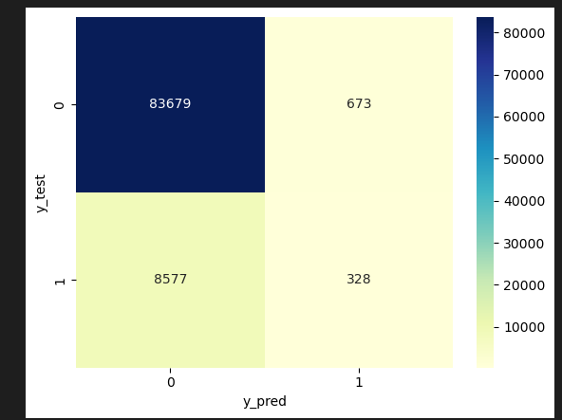
Modeling
Uses a Logistic Regression model to predict credit risk.
Trains the model on the training data and tests it on the test data.
Displays the prediction results and calculates the model's accuracy.

Slide 10

Thankyou

